Slide 1
Motion in a Straight Line
Kinematics in One Dimension

Slide 2

In this lecture you’ll learn
The fundamental quantities that describe motion
Position—change position→
Velocity—change velocity→
Acceleration—constant?
The difference between average and instantaneous quantities
The use of calculus to find instantaneous values
How to solve problems involving constant acceleration in one dimension
Including the constant acceleration of gravity near Earth’s surface

Slide 3
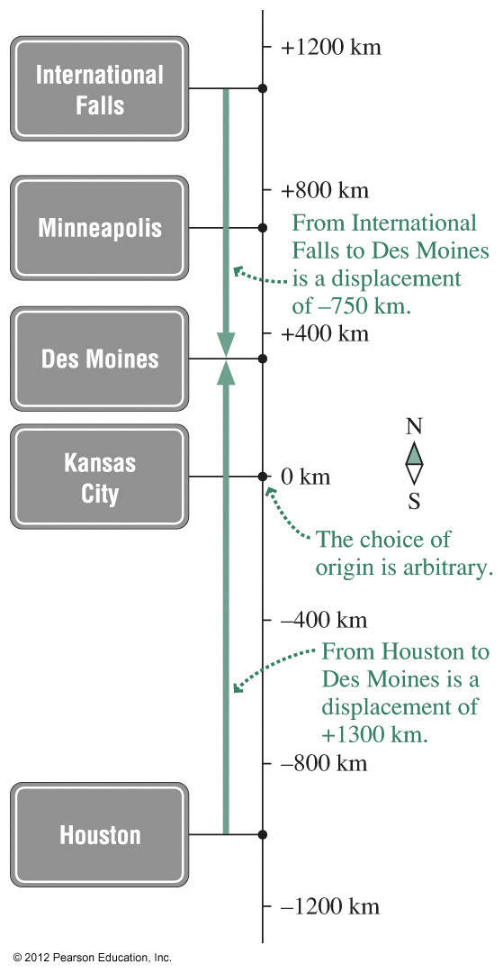
Position and Displacement
In one dimension, position can be described by a positive or negative number on a number line, also called a coordinate system.
Position zero, the origin of the coordinate system, is arbitrary and you’re free to choose it wherever it’s convenient.
Displacement is change in position.
For motion along the x direction, displacement is designated ∆x: ∆x = x₂–x₁ where x₁ and x₂ are the initial and final positions, respectively.

Slide 4
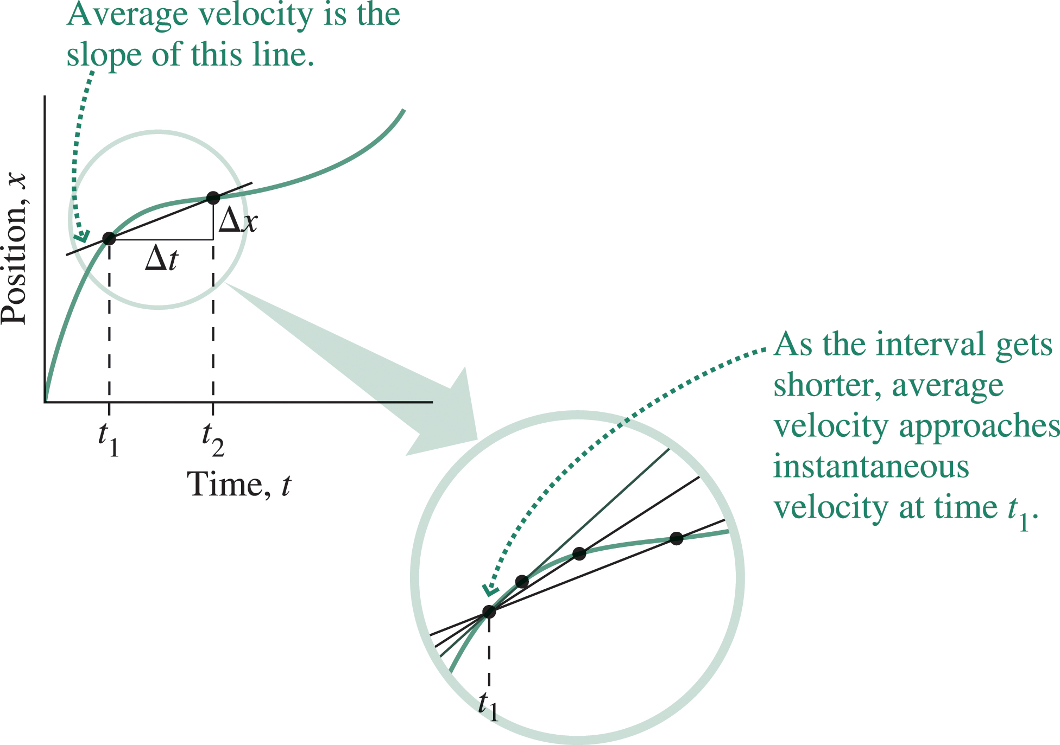
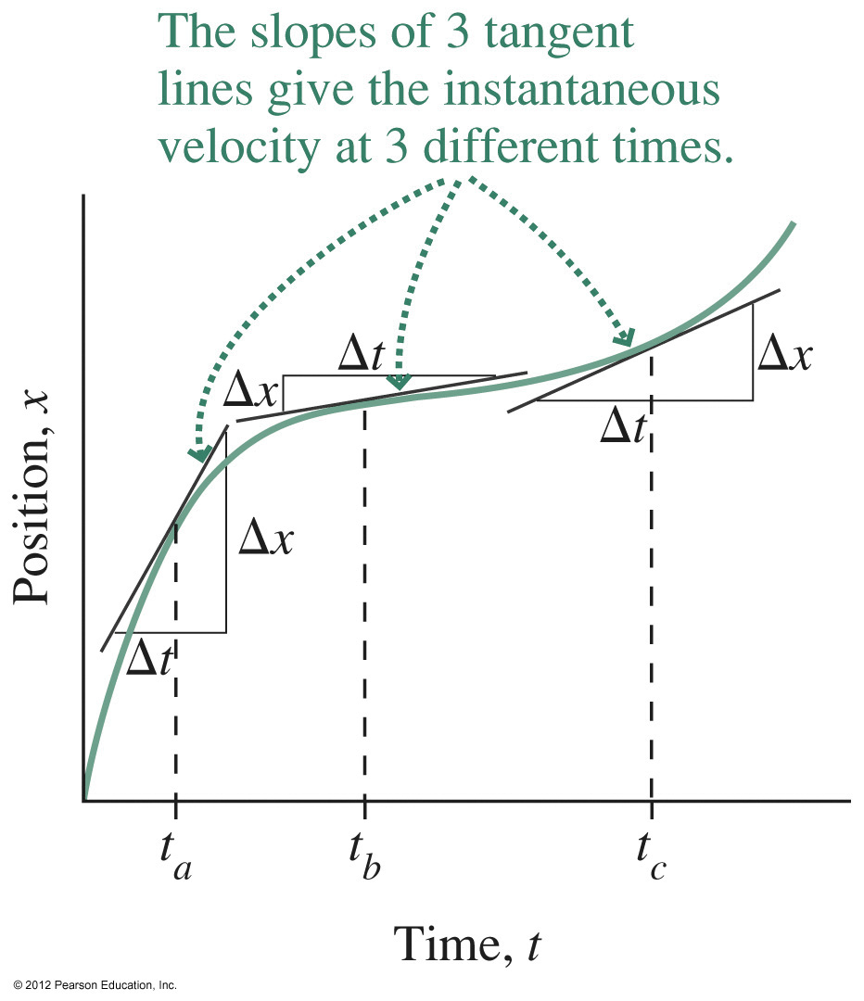
Velocity
Velocity is the rate of change of position.
Average velocity over a time interval ∆t is defined as the displacement divided by the time:
Instantaneous velocity is the limit of the average velocity as the time interval becomes arbitrarily short:
In calculus, this limiting procedure defines the derivative dx/dt.
Speed is the magnitude of velocity.
Velocity is the slope of the position-versus-time curve.

Slide 5
Using Calculus to Find Derivatives
In calculus, the derivative gives the result of the limiting procedure.
Derivatives of powers are straightforward:
Other common derivatives include the trig functions:

Slide 6
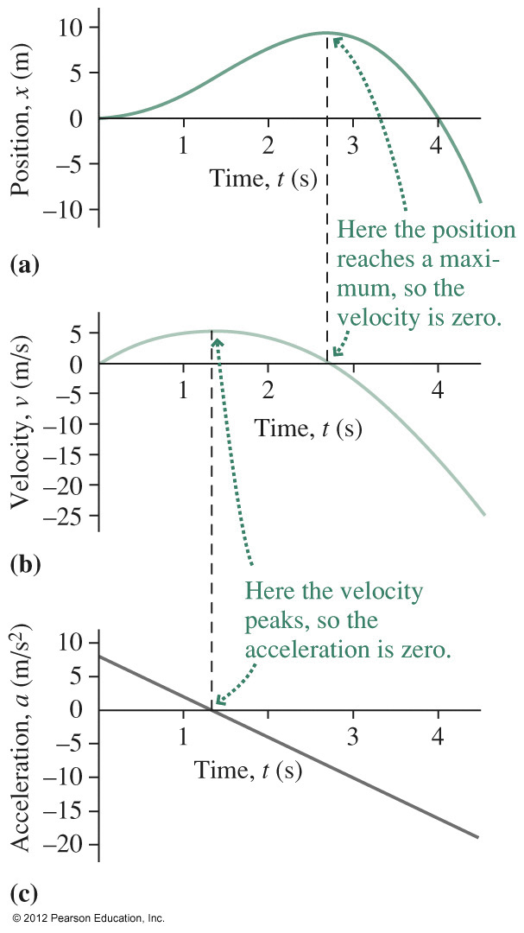
Acceleration
Acceleration is the rate of change of velocity.
Average velocity over a time interval ∆t is defined as the change in velocity divided by the time:
Instantaneous acceleration is the limit of the average acceleration as the time interval becomes arbitrarily short:
Acceleration is the slope of the velocity-versus-time curve.

Slide 7
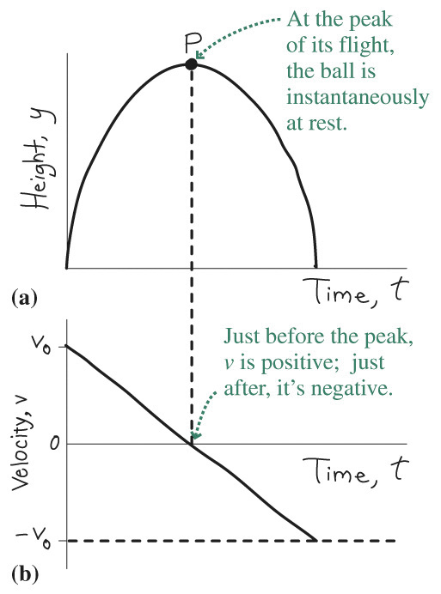
Position, Velocity, and Acceleration
Individual values of position, velocity, and acceleration aren’t related.
Instead, velocity depends on the rate of change of position.
Acceleration depends on the rate of change of velocity.
An object can be at position x = 0 and still be moving.
An object can have zero velocity and still be accelerating.
At the peak of its trajectory, a ball has zero velocity, but it’s still accelerating.

Slide 8
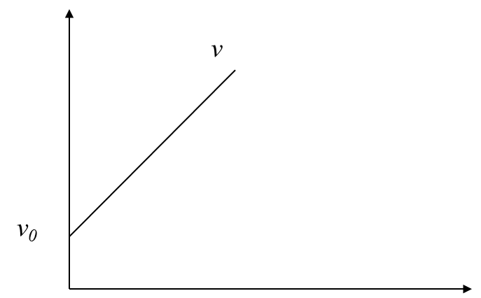
Derivation of Kinematic Equations

Slide 9
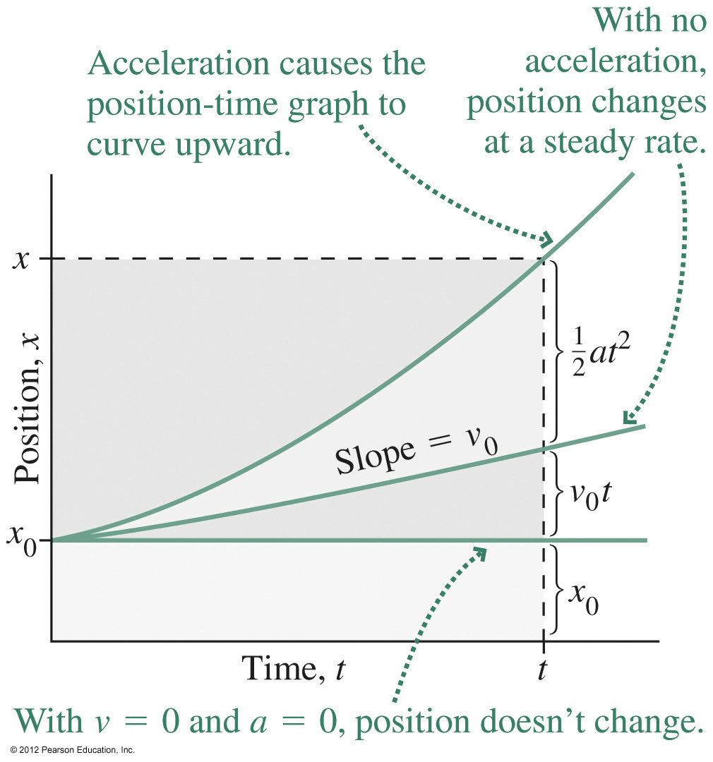
Constant Acceleration
When acceleration is constant, then position, velocity, acceleration, and time are related by where x₀ and v₀ are initial values at time t = 0, and x and v are the values at an arbitrary time t.
With constant acceleration
Velocity is a linear function of time
Position is a quadratic function of time

Slide 10
Example: constant a
t=0
t= 1 s
v=2 s
v=0
v=9.8m/s
v=19.8m/s

Slide 11
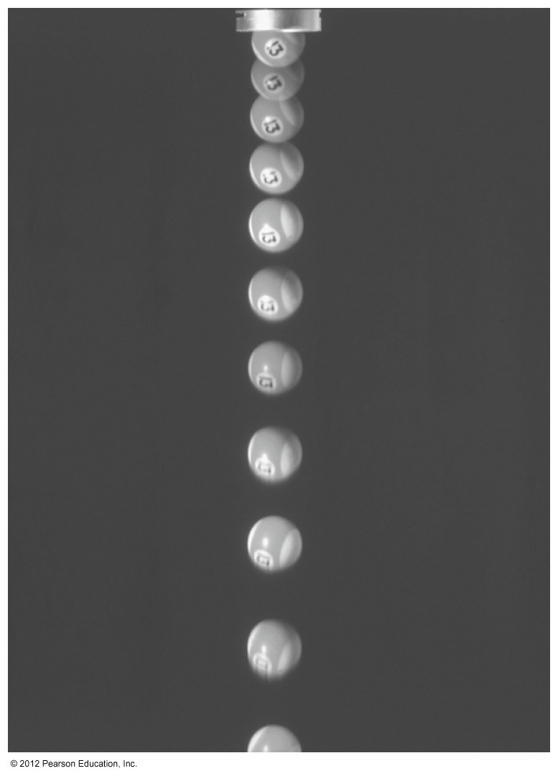
The Acceleration of Gravity
The acceleration of gravity at any point is exactly the same for all objects, regardless of mass.
Near Earth’s surface, the value of the acceleration is essentially constant at g = 9.8 m/s².
Therefore the equations for constant acceleration apply:
In a coordinate system with y axis upward, they read
This strobe photo of a falling ball shows increasing spacing resulting from the acceleration of gravity.

Slide 12
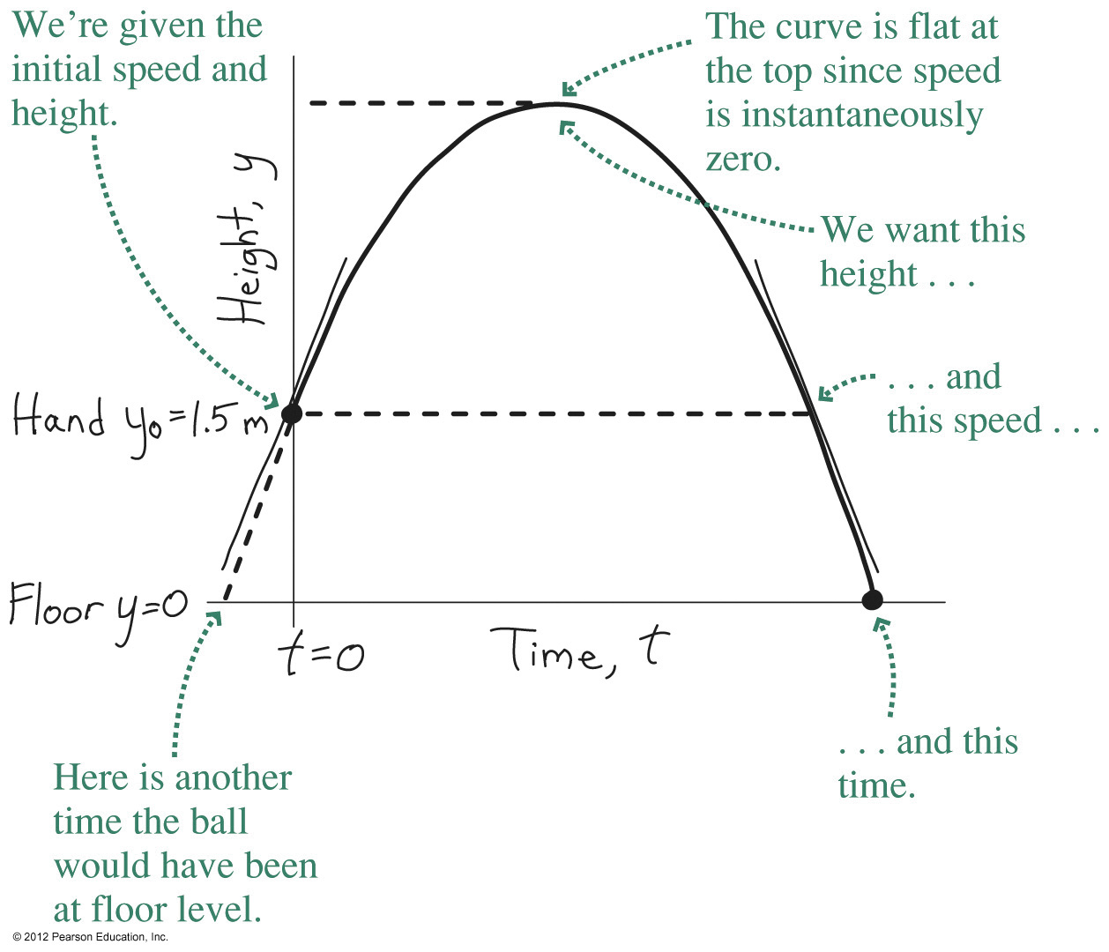
Example: The Acceleration of Gravity
A ball is thrown straight up at 7.3 m/s, leaving your hand 1.5 m above the ground. Find its maximum height and when it hits the floor.
At the maximum height the ball is instantaneously at rest (even though it’s still accelerating). Solving the last equation with v = 0 gives the maximum height:
Setting y = 0 in the third equation gives a quadratic in time; the result is the two values for the time when the ball is on the floor: t = –0.18 s and t = 1.7 s
The first answer tells when the ball would have been on the floor if it had always been on this trajectory; the second is the answer we want.

Slide 13
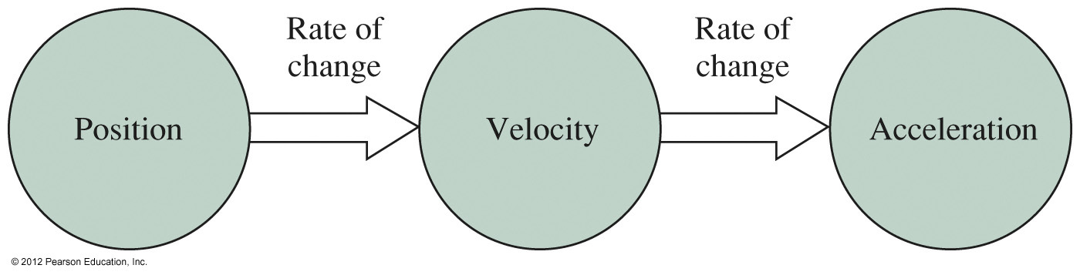
Summary
Position, velocity, and acceleration are the fundamental quantities describing motion.
Velocity is the rate of change of position.
Acceleration is the rate of change of velocity.
When acceleration is constant, simple equations relate position, velocity, acceleration, and time.
An important case is the acceleration due to gravity near Earth’s surface.
The magnitude of the gravitational acceleration is g = 9.8 m/s².

